Slide 1
Online Bookstore Application
PRESENTED BY :
A. RATNAKUMAR | S. SHIVAPRIYA | S. SAHIL BARICK
Intern - Java Batch

Slide 2
Project Overview :
Develop an online bookstore application that allows users to browse and purchase books.
The application will consist of a backend developed with Java Spring Boot and a frontend built using Angular.

Slide 3
Project Tasks :
1. Backend Setup:
Create a Java Spring Boot application with Spring Data JPA for managing book data.Define a Book entity with attributes like title, author, price, and availability.
2. RESTful API Development:
Implement RESTful endpoints to retrieve a list of books, view book details, and place orders.Handle inventory updates when orders are placed.
3. Frontend Development (Angular):
Create an Angular application for the frontend.Design user interfaces for browsing books, viewing book details, and managing the shopping cart.

Slide 4
Project Tasks :
4. User Authentication:
Implement user registration and login functionality using JWT (JSON WebTokens).
Secure sensitive endpoints such as order placement and user profile.
5. Shopping Cart Management:
Allow users to add and remove books from their shopping cart.
Display the total price and enable users to proceed to checkout.
6. Order History:
Develop a user dashboard that shows order history and order details

Slide 5




Technology Stack :
Front-End :
API Dev Tool:
HTTP Client Module
Back-End :
Database :

Slide 6
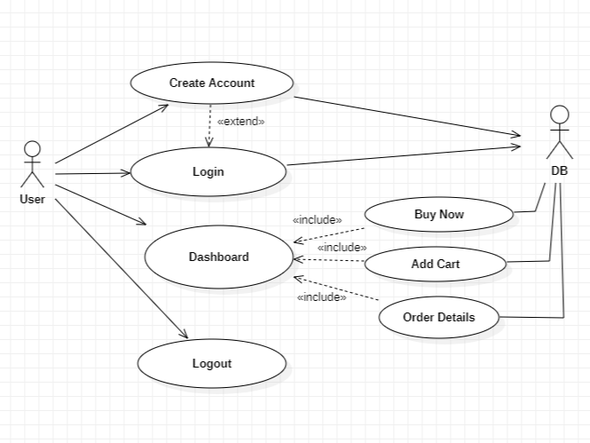
Use Case Diagram - User :
Fig 1 :- User - Use Case Diagram

Slide 7
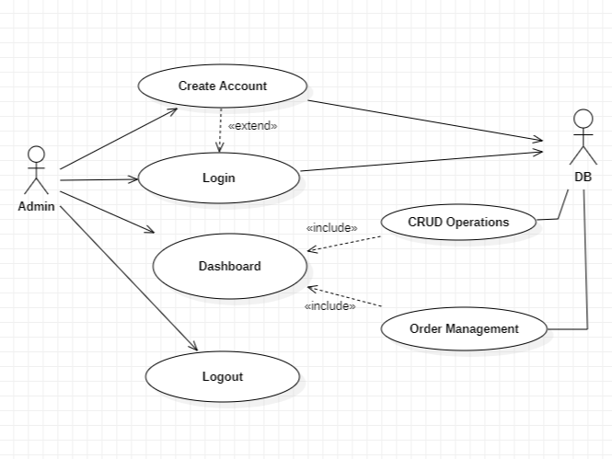
Use Case Diagram - Admin :
Fig 2 :- Admin - Use Case Diagram

Slide 8
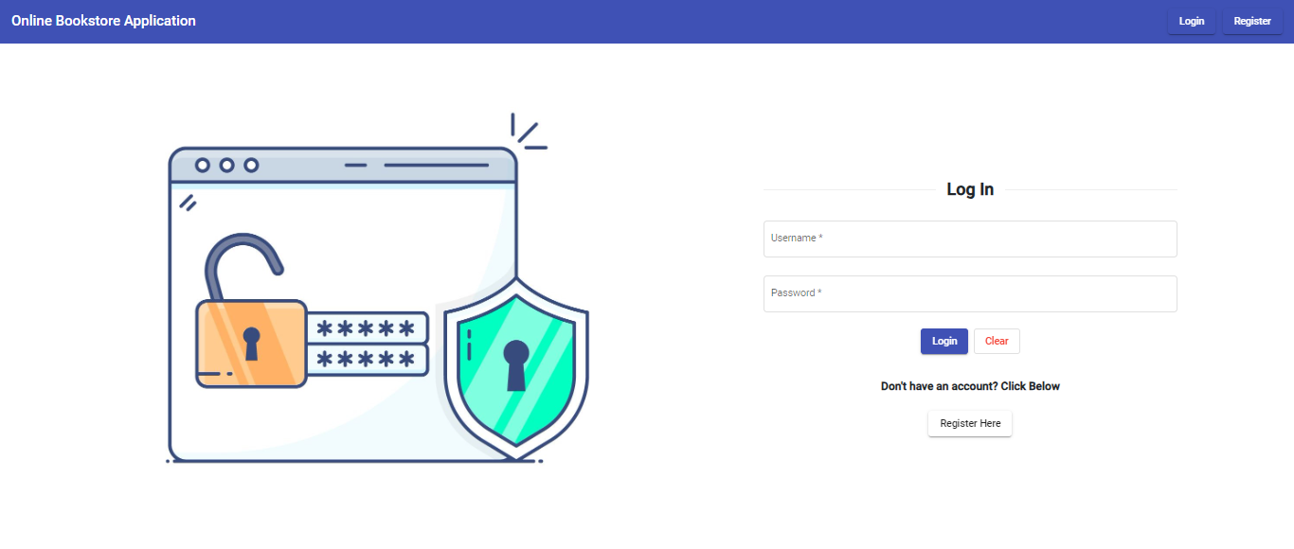
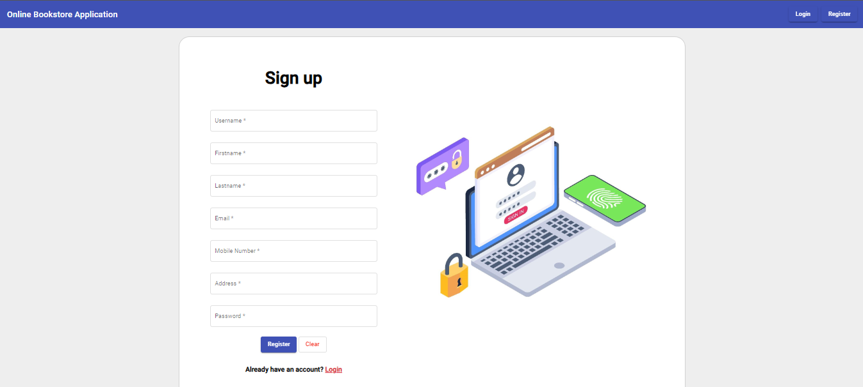
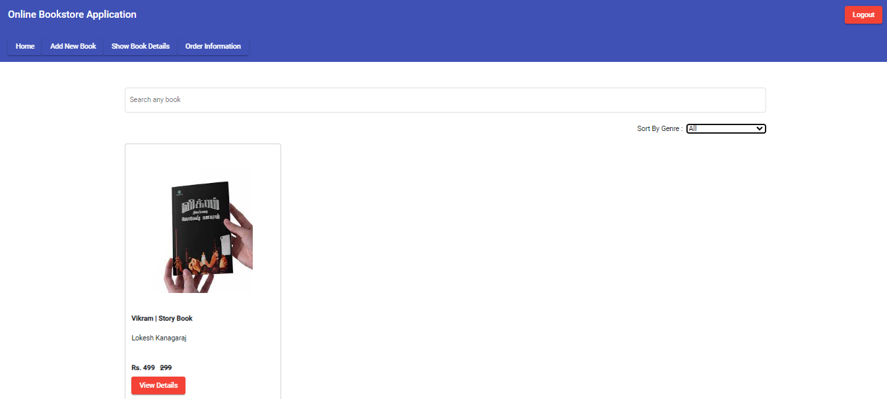
Output Attachments :

Slide 9
Project Outcome :
Upon completing this project, you will have built a functional online bookstore application with a Java Spring Boot backend and an Angular frontend.
This project will provide you with hands-on experience in full-stack development, RESTful API design, user authentication, shopping cart management, and building interactive user interfaces.

Slide 10
Thank you :)

